Slide 1
Musimorph's management team to benchmark R&D spending
Presented By
BIBEK LAMSAL

Slide 2
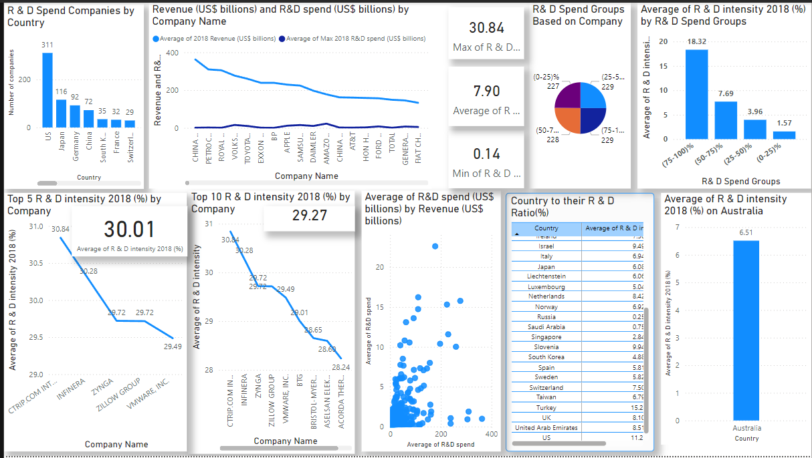
Visualization using dashboard

Slide 3
Insight:
Top 5 companies uses 30.01% of their revenue on R & D intensity compared to top 10 it’s 29.27% of their revenue on R & D intensity.
In Australia ,it’s 6.51% of average of their revenue spend in R & D intensity.
We should spend 7.90%-6.51% if we want to be on average R & D spending.
Countries like US , Japan, and Germany dominate in R&D intensity, driven by strong tech and automotive sectors.
A positive correlation exists between higher revenue and higher absolute R&D spend,

Slide 4
Recommandation
Comparing to top 5, Musimorph should target an R & D intensity within 29.49-30.84% spend from their revenue.
Comparing to top 10, Musimorph should target an R & D intensity within 28.24-30.48% spend from their revenue.
Musimorph should target an R&D intensity within the range of 6.1-7.9%, based on average peers in their industry.

Slide 5
Call Through Action
Let's set a meeting with the Financial Board team to review and finalize the allocation for Research and Development spending intensity.

